Slide 1

DATA
ANALYTICS

Slide 2
Data Analytics
Data analytics is the collection, transformation, and organization of data in order to draw conclusions, make predictions, and drive informed decision making.
data analysis is a subcategory of data analytics that deals specifically with extracting meaning from data
Data analytics, as a whole, includes processes beyond analysis, including data science (using data to theorize and forecast) and data engineering (building data systems).

Slide 3
Data Analytics
Data analytics is a multidisciplinary field that employs a wide range of analysis techniques, including math, statistics, and computer science, to draw insights from data sets.
Data analytics is a broad term that includes everything from simply analyzing data to theorizing ways of collecting data and creating the frameworks needed to store it.

Slide 4
Why do we need data analytics?
Data analysis helps businesses acquire relevant, accurate information, suitable for developing future marketing strategies, business plans, and realigning the company's vision or mission.

Slide 5
Data Analysis – Types
Data Analysis methods are:
– Text Analysis
the process of using computer systems to read and understand human-written text
– Statistical Analysis
the collection and interpretation of data in order to uncover patterns and trends

Slide 6
Data Analysis – Types
– Diagnostic Analysis
examines data to understand the root causes of events, behaviours, and outcomes. tell us why something happened
– Predictive Analysis
identify correlations between sensor readings, tell us what will likely happen in the future.
– Prescriptive Analysis
the process of using data to determine an optimal course of action, tell us how to act.

Slide 7
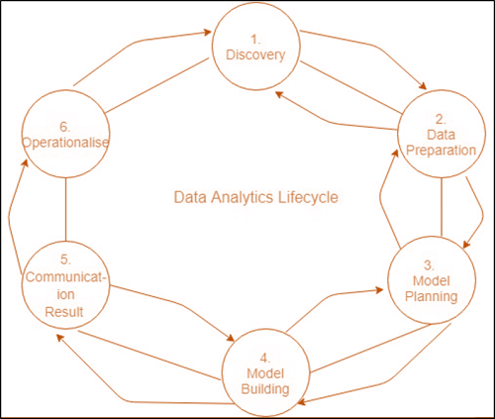
Life Cycle of Data Analytics

Slide 8
Life Cycle of Data Analytics
Phase 1: Discovery
The data science team is trained and researches the issue.
Create context and gain understanding.
Learn about the data sources that are needed and accessible to the project.
The team comes up with an initial hypothesis, which can be later confirmed with evidence.

Slide 9
Life Cycle of Data Analytics
Phase 2: Data Preparation
Methods to investigate the possibilities of pre-processing, analysing, and preparing data before analysis and modelling.
It is required to have an analytic sandbox. The team performs, loads, and transforms to bring information to the data sandbox.
Data preparation tasks can be repeated and not in a predetermined sequence.
Some of the tools used commonly for this process include - Hadoop, Alpine Miner, Open Refine, etc.

Slide 10
Life Cycle of Data Analytics
Phase 3: Model Planning
The team studies data to discover the connections between variables. Later, it selects the most significant variables as well as the most effective models.
In this phase, the data science teams create data sets that can be used for training for testing, production, and training goals.
The team builds and implements models based on the work completed in the modelling planning phase.
Some of the tools used commonly for this stage are MATLAB and STASTICA.

Slide 11
Life Cycle of Data Analytics
Phase 4: Model Building
The team creates datasets for training, testing as well as production use.
The team is also evaluating whether its current tools are sufficient to run the models or if they require an even more robust environment to run models.
Tools that are free or open-source or free tools Rand PL/R, Octave, WEKA.
Commercial tools - MATLAB, STASTICA.

Slide 12
Life Cycle of Data Analytics
Phase 5: Communication Results
Following the execution of the model, team members will need to evaluate the outcomes of the model to establish criteria for the success or failure of the model.
The team is considering how best to present findings and outcomes to the various members of the team and other stakeholders while taking into consideration cautionary tales and assumptions.
The team should determine the most important findings, quantify their value to the business and create a narrative to present findings and summarize them to all stakeholders.

Slide 13
Life Cycle of Data Analytics
Phase 6: Operationalize
The team distributes the benefits of the project to a wider audience. It sets up a pilot project that will deploy the work in a controlled manner prior to expanding the project to the entire enterprise of users.
This technique allows the team to gain insight into the performance and constraints related to the model within a production setting at a small scale and then make necessary adjustments before full deployment.
The team produces the last reports, presentations, and codes.
Open source or free tools such as WEKA, SQL, MADlib, and Octave.

Slide 14
